Slide 1


Slide 2
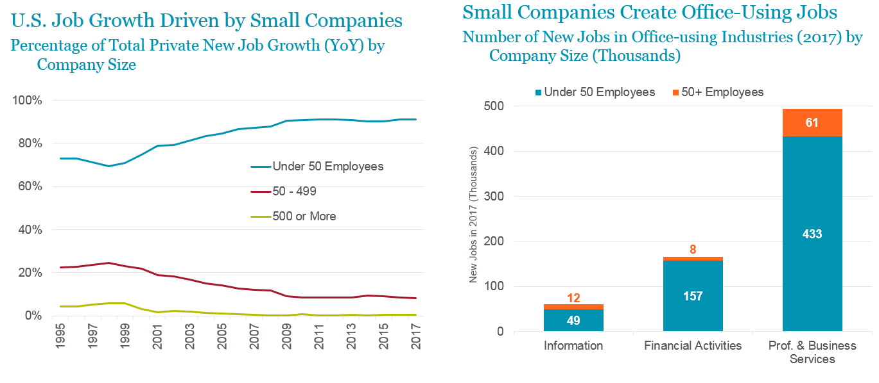
Small Companies Drive U.S. Job Growth
Source: Bureau of Labor Statistics
Source: Bureau of Labor Statistics; Cushman & Wakefield Research
Notes:
Left: Companies with under 50 employees create 9 out of 10 new U.S. jobs.
Right: Small firms in office-using industries—professional & business services, financial activities, and information—were responsible for the creation of 640,000 jobs in 2017. Larger firms in the same industries added a total of 81,000 jobs.

Slide 3
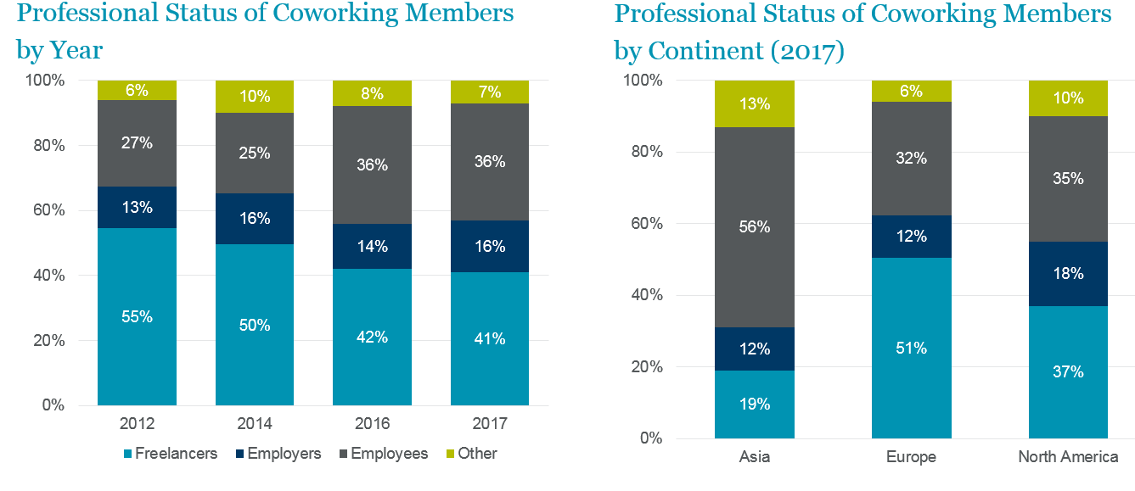
Coworking Moving Towards Larger Occupiers
Source: deskmag 2017 Global Coworking Survey
Source: deskmag 2017 Global Coworking Survey

Slide 4
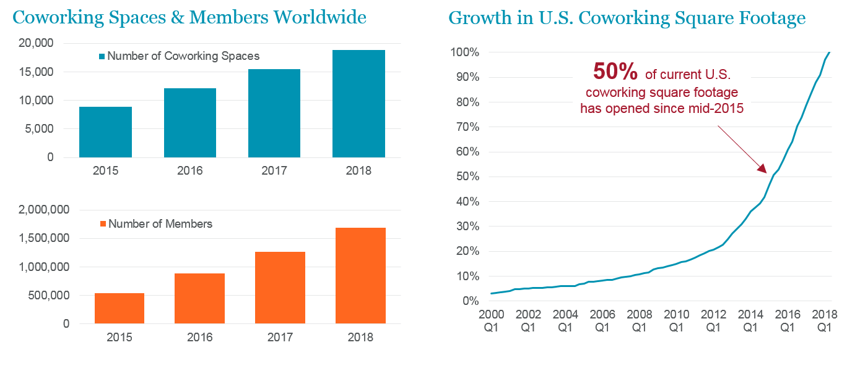
Coworking Experiencing Strong Growth
Source: deskmag 2018 Global Coworking Forecast
Source: CoStar Group; Cushman & Wakefield Research

Slide 5
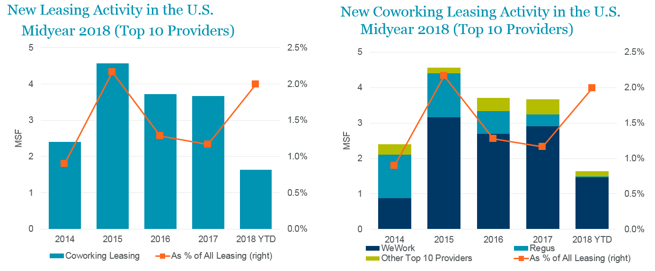
Demand Has Been Strong For 3.5+ Years
Source: CoStar Group; Cushman & Wakefield Research
Source: CoStar Group; Cushman & Wakefield Research

Slide 6
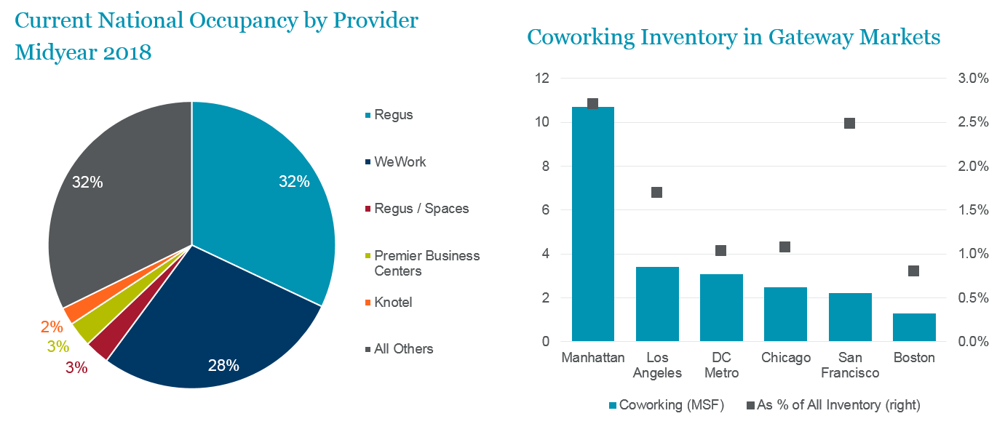
Coworking Concentrated with Few Large Companies
Source: CoStar Group; Cushman & Wakefield Research
Source: CoStar Group; Cushman & Wakefield Research

Slide 7
Coworking Concentrated in Large Markets
Market | Coworking Space (msf) | Spec Suites (msf) *as of August 2018 | Total Flexible Office Space (msf) | Total Flexible Space as % of Total Inventory
United States | 45+ | 15 | 60 | 1.1%
Gateway Markets | 23.0 | 7.0 | 30.0 | 2.5%
Boston | 1.3 | 0.1 | 1.4 | 0.9%
Chicago | 2.5 | 1.8 | 4.3 | 1.8%
Los Angeles | 3.4 | 1.0 | 4.4 | 2.2%
Manhattan | 10.7 | 1.0 | 11.7 | 3.0%
San Francisco | 2.0 | 0.3 | 2.3 | 2.9%
Washington, DC Metro | 3.1 | 2.7 | 5.8 | 1.9%
Source: CoStar Group; Instant Group; Cushman & Wakefield Research

Slide 8
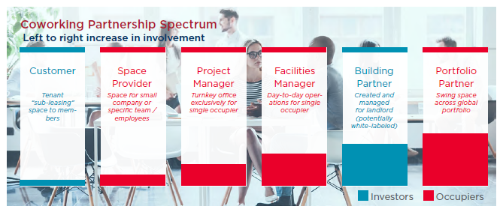
Coworking Providers Broadening Services
Source: Cushman & Wakefield Research

Slide 9
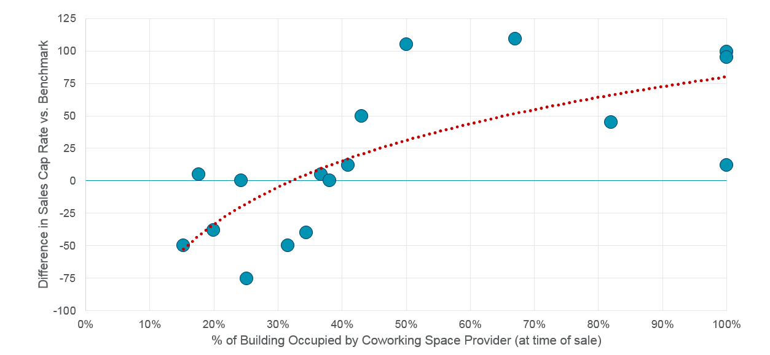
Cap Rates Impacted by Coworking Occupancy
Sales of Buildings with Coworking Space Occupancy (Q1 2016 - Q1 2018)
*Circles represent individual sale
Source: Real Capital Analytics; Cushman & Wakefield Research
Notes:
Cap rate data from sales over the past two years indicate that investors have been giving a cap rate premium for buildings with WeWork occupying a third or less of the building. However, as the proportion of the building leased to WeWork increases so does the gap between the building’s sale cap rate and the cap rate benchmark for other sales in the same sub-market.

Slide 10


